Slide 1
Classify Time Series Using Wavelet Analysis and Deep Learning
Adarsha Bhattarai

Slide 2
AI Project
Classify human electrocardiogram (ECG) signals using the continuous wavelet transform (CWT) and a deep convolutional neural network (CNN).

Slide 3
Training CNN
Training deep CNNs from scratch is resource-intensive and data-demanding.
Transfer learning offers a solution by using pretrained neural networks for similar tasks.
In this case, we apply transfer learning to adapt GoogLeNet.

Slide 4
GoogLeNet
These pretrained models, originally for image recognition, are used to classify ECG waveforms in a time-frequency format.

Slide 5
Dataset
We reuse the network architecture of the CNN to classify ECG signals based on images from the CWT of the time series data.
The data used in this example are publicly available from PhysioNet.

Slide 6
Dataset
ECG recordings from three groups—arrhythmia (ARR), congestive heart failure (CHF), and normal sinus rhythm (NSR).

Slide 7
Dataset
162 ECG recordings from three PhysioNet databases:
MIT-BIH Arrhythmia Database
MIT-BIH Normal Sinus Rhythm Database
BIDMC Congestive Heart Failure Database Recordings

Slide 8
Dataset
96 ARR recordings
30 CHF recordings
36 NSR recordings

Slide 9
Objective
Train a classifier to differentiate between ARR, CHF, and NSR.

Slide 10
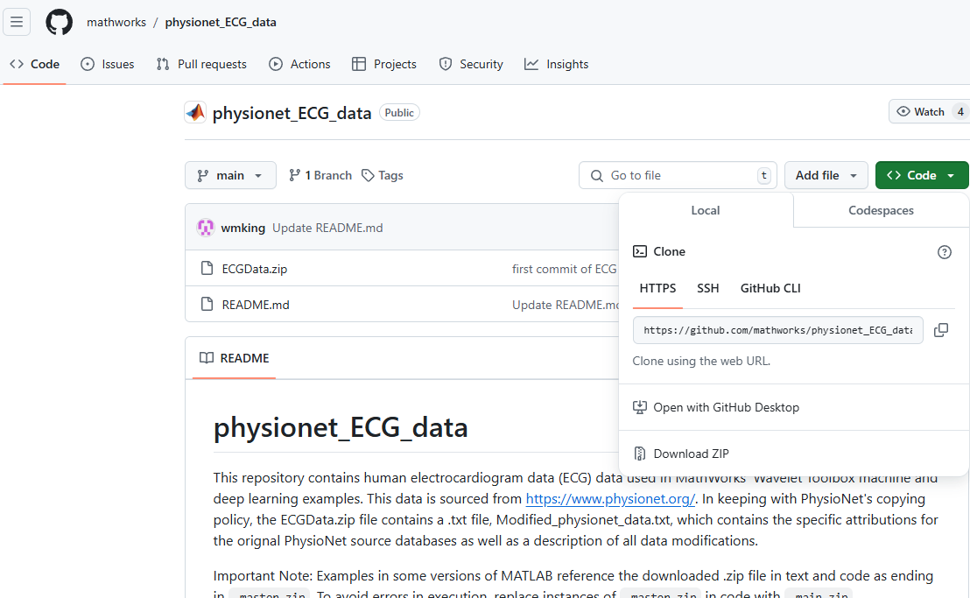
GitHub Repo
https://github.com/mathworks/physionet_ECG_data/

Slide 11
1. MATLAB
unzip(fullfile("physionet_ECG_data-main.zip"))
unzip(fullfile("ECGData.zip"))

Slide 12
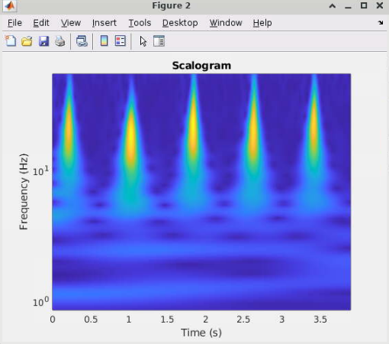
2. MATLAB
Fs = 128;
fb = cwtfilterbank(SignalLength=500, ...
SamplingFrequency=Fs, ...
VoicesPerOctave=12);
sig = ECGData.Data(1,1:500);
[cfs,frq] = wt(fb,sig);
t = (0:499)/Fs;
figure
pcolor(t,frq,abs(cfs))
set(gca,"yscale","log")
shading interp
axis tight
title("Scalogram")
xlabel("Time (s)")
ylabel("Frequency (Hz)")

Slide 13
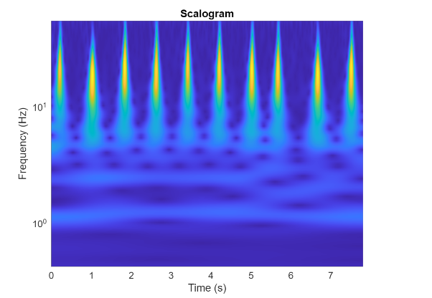
3. MATLAB: Task 2
Plot a Scalogram with 1000 ECG samples

Slide 14
4. MATLAB
parentDir = '/home/cest4mri/adarsha053/Fall 2024 CEST AI/physionet_ECG_data-main’;
dataDir = "data";

Slide 15
5. MATLAB
%% Step 4
helperCreateECGDirectories(ECGData,parentDir,dataDir)
%% Step 5
helperCreateRGBfromTF(ECGData,parentDir,dataDir)

Slide 16
6. MATLAB
function helperCreateECGDirectories(ECGData,parentFolder,dataFolder)
% This function is only intended to support the ECGAndDeepLearningExample.
% It may change or be removed in a future release.
rootFolder = parentFolder;
localFolder = dataFolder;
mkdir(fullfile(rootFolder,localFolder))
folderLabels = unique(ECGData.Labels);
for i = 1:numel(folderLabels)
mkdir(fullfile(rootFolder,localFolder,char(folderLabels(i))));
end
end

Slide 17
7. MATLAB
function helperCreateRGBfromTF(ECGData,parentFolder,childFolder)
% This function is only intended to support the ECGAndDeepLearningExample.
% It may change or be removed in a future release.
imageRoot = fullfile(parentFolder,childFolder);
data = ECGData.Data;
labels = ECGData.Labels;
[~,signalLength] = size(data);
fb=cwtfilterbank('SignalLength',signalLength,'Wavelet','amor','VoicesPerOctave',12);
r = size(data,1);
for ii = 1:r
cfs = abs(fb.wt(data(ii,:)));
im = ind2rgb(round(rescale(cfs,0,255)),jet(128));
imgLoc = fullfile(imageRoot,char(labels(ii)));
imFileName = char(labels(ii))+"_"+num2str(ii)+".jpg";
imwrite(imresize(im,[224 224]),fullfile(imgLoc,imFileName));
end
end

Slide 18
8. Divide into Training and Validation Data
Efficient Image Loading with imageDatastore: Automatically labels images based on folder names.
Stores images as an ImageDatastore object, optimized for large datasets.
Handles data that doesn’t fit in memory.
Reads images in batches, ideal for CNN training.
allImages = imageDatastore(fullfile(parentDir,dataDir), ...
"IncludeSubfolders",true, ...
"LabelSource","foldernames");

Slide 19
9. Divide into Training and Validation Data
Randomly divide the images into two groups, one for training and the other for validation.
Use 80% of the images for training, and the remainder for validation.
[imgsTrain,imgsValidation] = splitEachLabel(allImages,0.8,"randomized");
disp("Number of training images: "+num2str(numel(imgsTrain.Files)))
disp("Number of validation images: "+num2str(numel(imgsValidation.Files)))

Slide 20
References
https://www.mathworks.com/help/wavelet/ug/classify-time-series-using-wavelet-analysis-and-deep-learning.html

